Slide 1
Introduction
21AIE213 - Robot Operating System and Robot Simulation

Slide 2
Lecture Overview
Course Overview
ROS - Definition
ROS - History
ROS - Philosophy
Why ROS ?
ROS Robots
Distributions of ROS

Slide 3
Course Overview
Course Objectives
To provide an introductory understanding on robotics operating system and gazebo simulation environment.
To introduce the students with module developments in ROS for mobile robot control, navigation and environment mapping.
To introduce the students with module developments in ROS for industrial robot control, path planning and trajectory planning.
Course Outcomes
CO 1:To develop simple applications to control robot motion
CO 2:To master the basics of ROS module development for robots
CO 3:To program the robots to perform simple and specific tasks

Slide 4
Course Overview - Text Book / Reference Books
Programing Robots with ROS , M. Quigley, B. Gerkey, and W. D. Smart , Oreilly Publishers, 2015.
ROS Robotics by example , Fairchild & Harman, PACKT Publishing, 2016
Mastering ROS for Robotics Programming: Design, build, and simulate complex robots using the Robot Operating System, Joseph, Lentin, and Jonathan Cacace, Packt Publishing Ltd, 2018.

Slide 5
Course Overview - Hands On Sessions
+
Image Courtesy: http://so.engineering
Robot Operating System
Image Courtesy: http://gazebosim.org
Gazebo Simulator

Slide 6
Course Overview - Evaluation
Internal: 70 Marks
2 Quizzes : 10 Marks each
3 Lab Evaluations : 10 Marks each
Mid Semester Exam : 20 Marks
External: 30 Marks
Course Project (Group) : 30 Marks

Slide 7
ROS - Definition
ROS is an open-source, meta-operating system for your robot. It provides the services you would expect from an operating system, including hardware abstraction, low-level device control, implementation of commonly-used functionality, message-passing between processes, and package management.
ros.org

Slide 8
ROS - History
ROS is a large project that has many ancestors and contributors.
The need for an open collaboration framework was felt by many people in the robotics research community.
2000 - Stanford University - STanford AI Robot (STAIR) and the Personal Robots (PR) program
2007 - Willow Garage, Inc., a nearby robotics incubator, provided significant resources to extend these concepts much further and create well-tested implementations
From the start, ROS was being developed at multiple institutions and for multiple robots.
The ROS ecosystem now consists of tens of thousands of users worldwide, working in domains ranging from tabletop hobby projects to large industrial automation systems.

Slide 9
ROS - Philosophy
All software frameworks impose their development philosophies on their contributors directly or indirectly.
ROS follows the Unix philosophy of software development in several key aspects
Peer to peer - ROS systems consist of numerous small computer programs that connect to one another and continuously exchange messages.
Tools-based - Unlike many other robotics software frameworks, ROS does not have a canonical integrated development and runtime environment. Complex software systems can be created from many small, generic programs.

Slide 10
ROS - Philosophy
Multilingual - Based on the software languages, its characteristic is determined,
Scripting language - high-productivity
Performance - C++
Other popular languages - Lisp, MATLAB
Which is better ???
ROS software modules can be written in any language for which a client library has been written.
At the time of writing, client libraries exist for C++, Python, LISP, Java, JavaScript, MATLAB, Ruby, Haskell, R, Julia, and others
We will use Python in this course

Slide 11
ROS - Philosophy
Thin - The ROS conventions encourage contributors to create standalone libraries and then wrap those libraries so they can send and receive messages to and from other ROS modules
Free and open source - The core of ROS is released under the permissive BSD license, which allows commercial and noncommercial use
ROS passes data between modules using interprocess communication (IPC) which means that systems built using ROS can have fine-grained licensing of their various components

Slide 12
Why ROS ?
ROS philosophy
Lets consider a typical example of a “Fetch an Item” task by an office assistant robot. There are several sub modules involved
Request communication - SMS, voice command, web interface etc.
Planning and Navigation - Plan to reach the destination were the object is placed. This can involve navigating through various rooms in a building, perhaps including elevators and doors.
Object Recognition and Picking - Once arriving in a room, the robot must search desks cluttered with similarly sized objects
Navigating Back - The robot must then retrace its steps and deliver the object to the desired location.
This is relatively a simple task !!!

Slide 13
Why ROS ?
Dealing with real-world variations in complex tasks and environments is so difficult that no single individual, laboratory, or institution can hope to build a complete system from scratch.
As a result, ROS was built from the ground up to encourage collaborative robotics software development
Every sub module in the “Fetch an Item” example can be developed by various organization.
ROS includes many features specifically designed to simplify this type of large-scale collaboration

Slide 14
ROS Robots
There is a long list of robots on the ROS wiki website, http://wiki.ros.org/ Robots, which use ROS.
Some robots are
TurtleBot, a mobile robot
Baxter, a friendly two-armed robot
Crazyflie and Bebop, flying robots

Slide 15
ROS Robots
Image Courtesy: ROS Robotics by example by Fairchild & Harman
TurtleBot

Slide 16
ROS Robots
Image Courtesy: ROS Robotics by example by Fairchild & Harman
Baxter

Slide 17
ROS Robots
Image Courtesy: ROS Robotics by example by Fairchild & Harman
Bebop and Crazyflie

Slide 18
Distributions of ROS
ROS 1 | ROS 2
ROS Box Turtle - 2010 ROS C Turtle - 2010 ROS Diamondback - 2011 ROS Electric Emys - 2011 ROS Fuerte Turtle - 2012 ROS Groovy Galapagos - 2012 ROS Hydro Medusa - 2013 ROS Indigo Igloo - 2014 ROS Jade Turtle - 2015 ROS Kinetic Kame - 2016 ROS Lunar Loggerhead - 2017 ROS Melodic Morenia - 2018 ROS Noetic Ninjemys - 202] | Alpha1-alpha8 - 2015 Beta1 - 2016 Beta 2 - 2017 Beta 3 - 2017 Ardent Apalone - 2017 Bouncy Bolson - 2018 Crystal Clemmys - 2018 Dashing Diademeta - 2019 Eloquent Elusor - 2019 Foxy Fitzroy - 2020 Galatic Geochelone - 2021 Humble Hawksbill - 2022
ROS1 - Runs on Unix based platform. Ubuntu is recommended
ROS2 - Runs on Ubuntu, MacOS and Windows

Slide 19
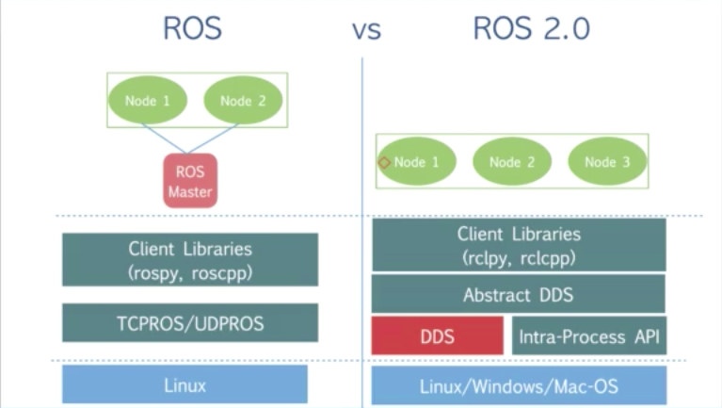
ROS1 Vs ROS2
Image Courtesy: Prof. Anis Koubaa, ROS Udemy Course

Slide 20
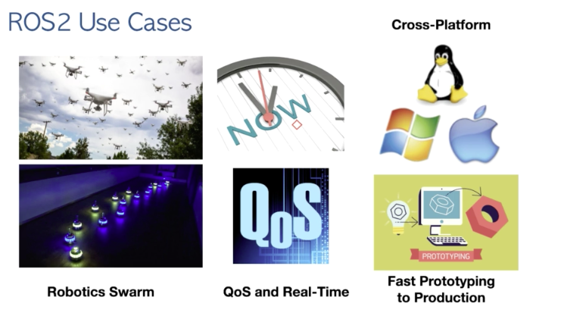
ROS 2 Use Cases
Image Courtesy: Prof. Anis Koubaa, ROS Udemy Course

Slide 21
Thank You !!!

